Slide 1
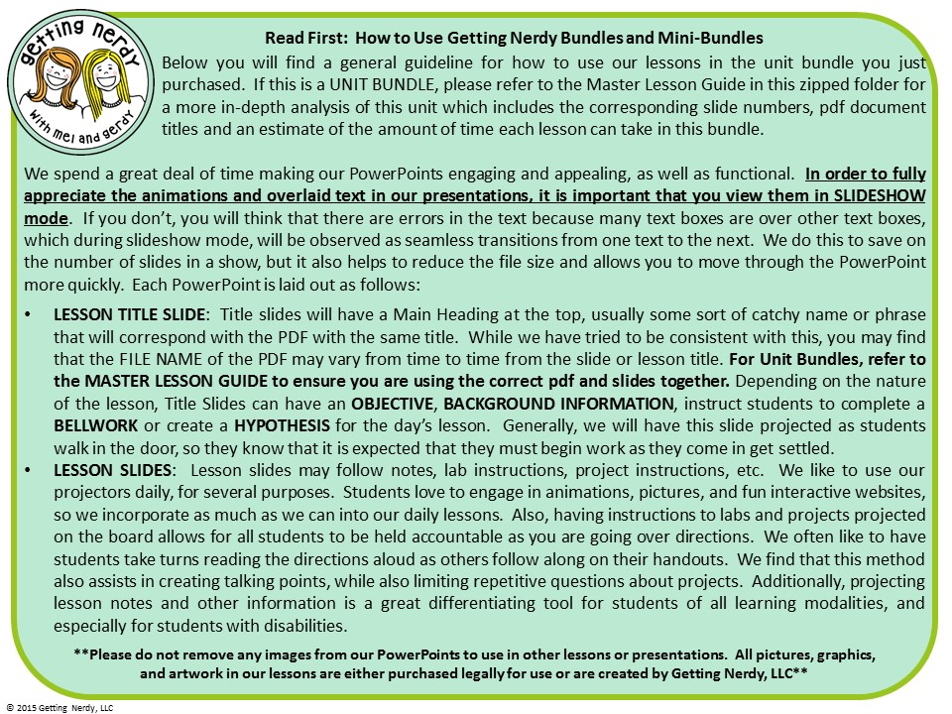

Slide 2


Slide 3


Slide 4
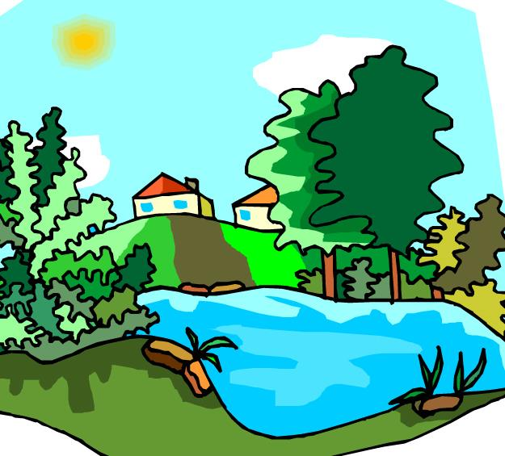

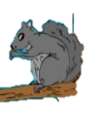
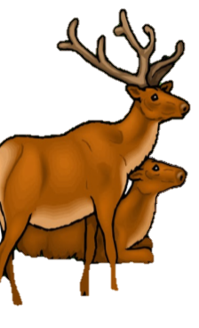


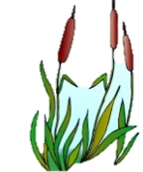
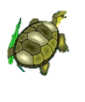

Interactions Within the Environment
Objective: Describe how living things interact with each other and their environment.
Bell work: Give some examples of living things interacting with each other or their environment from this picture.
Ex: The elk is sitting on the grass
© Getting Nerdy, LLC

Slide 5
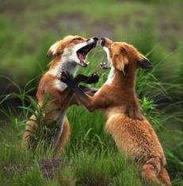
Take a few minutes to read the passage “Interactions Within The Environment.”
When complete, find the correct term for the definitions on your sheet. Remember to use good reading strategies as you read!
© Getting Nerdy, LLC

Slide 6
What’s in an Ecosystem?
It’s a Frog’s World…
Objective: to determine how organisms are organized by their interactions
Bell work:
What is the smallest unit of living things?
cells
What does the prefix “bio” mean?
life; living
List two living factors and two non-living factors of the ecosystem shown.
aaa
© Getting Nerdy, LLC

Slide 7
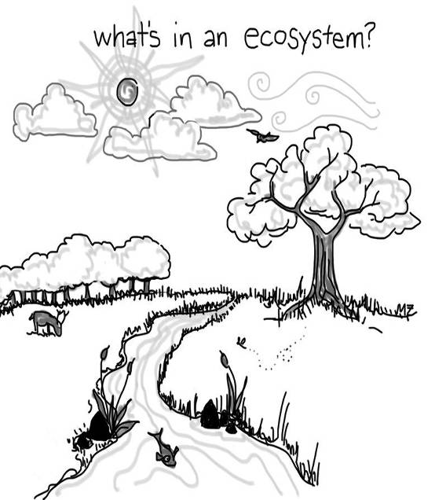
Ecology: the study of how living things interact with each other and their environment. Every living thing is made of cells!
An ecosystem is made up of all of the living (BIOTIC) and non-living (ABIOTIC) factors.
In the picture, place a CIRCLE AROUND things that are LIVING and an “X” over things that are NON-LIVING.
© Getting Nerdy, LLC

Slide 8
Atoms
Molecules
Organelles
Cells
Tissues
Organs
Organ Systems
Organisms
Populations
Communities
Ecosystems
Biosphere
The Universe
All of science builds upon levels: every living organism is made up of CELLS - tiny living units that can live alone (unicellular) or combine to make more complex things like tissues, organs, organ systems and organisms (multicellular); hence, the Levels of Organization.
ORGANISMS are organized into levels by how they interact with one another, which will take us into the Levels of Organization for Ecology. We have several types of organisms, and their type tells us how the organisms interact.
© Getting Nerdy, LLC

Slide 9
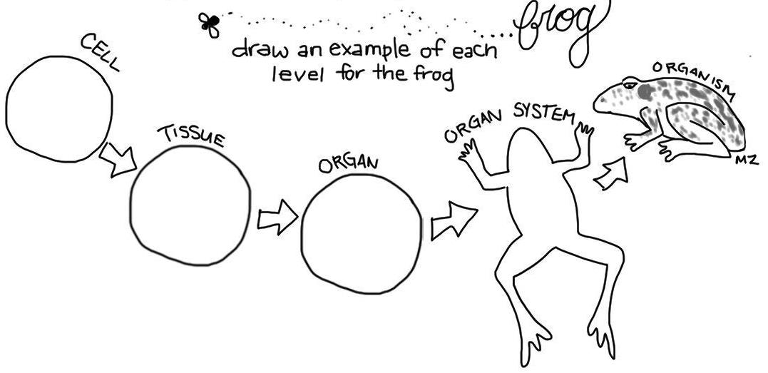
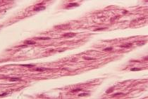

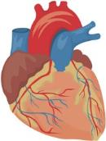
Now, create your own levels of organization for the frog. Each level must build upon the previous level. For example, if you draw a cardiac muscle cell, then you should draw cardiac muscle tissue, a heart, & the cardiovascular system.
Cellular level (muscle cell)
Organism level (consisting of many organ systems)
Organ system level (cardiovascular system)
Tissue level (muscle tissue)
Organ level (heart)
© Getting Nerdy, LLC

Slide 10
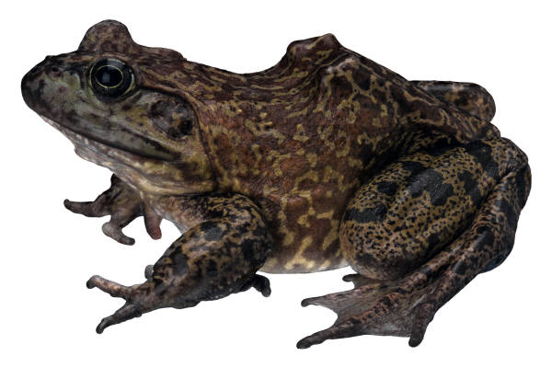
Organism: a single living thing that obtains food, water, and shelter to live, grow, and reproduce in its habitat (environment). An organism’s niche is its total way of life.
Ex: frog
© Getting Nerdy, LLC

Slide 11
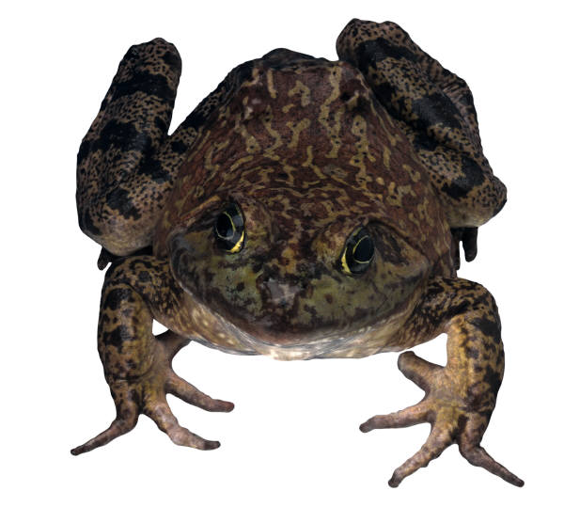
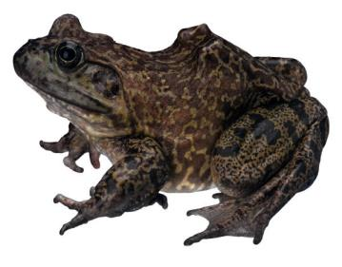


Population: A group of interbreeding organisms (species) living in the same area
Ex: All of the frogs living in a pond behind your neighborhood
© Getting Nerdy, LLC

Slide 12
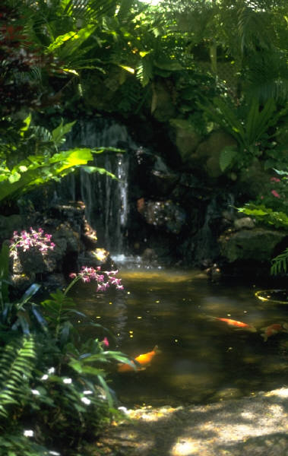

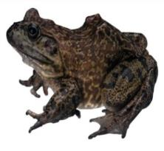


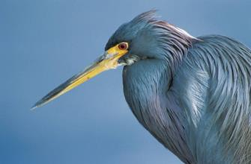
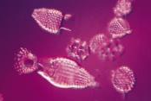
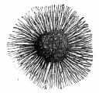
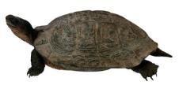
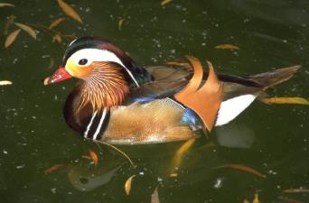
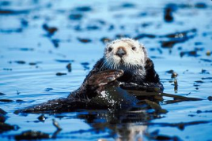
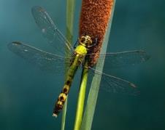
Community: all the populations in an ecosystem
Ex: All the frogs, insects, reptiles, birds, plants, mushrooms, bacteria, protists, mammals & fish living in the pond behind your neighborhood
© Getting Nerdy, LLC

Slide 13

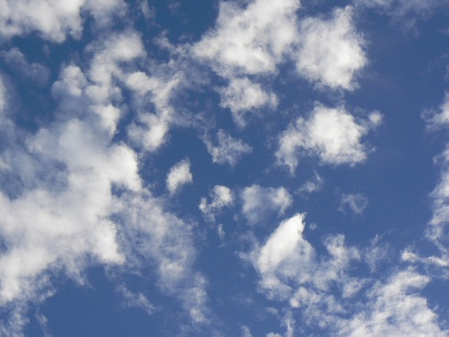
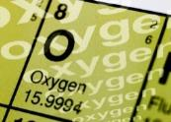

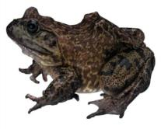
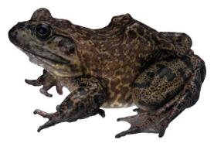

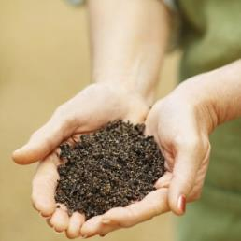

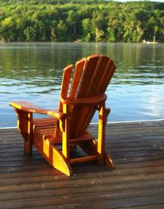
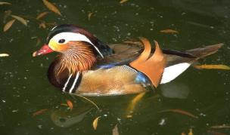

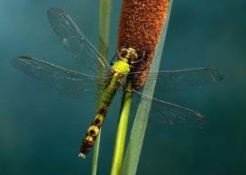
Ecosystem/Biome : Includes all the living (biotic) & nonliving (abiotic) features of an environment. There are several major types of ecosystems such as a rainforest, desert, tundra, deciduous forest, taiga, marine, etc.
Ex: All the frogs, insects, birds, reptiles, plants, mushrooms, bacteria, mammals & fish along with water, soil, air, clouds, sunlight, and man-made materials in the pond behind your neighborhood
© Getting Nerdy, LLC

Slide 14
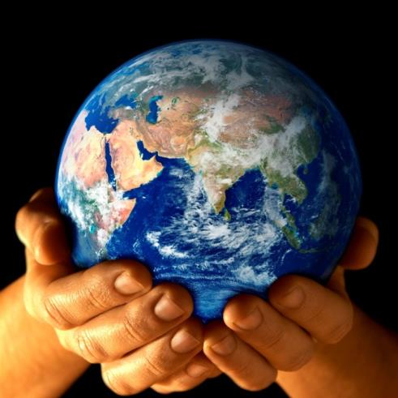
Biosphere: every place on Earth that can support life
Atmosphere
Lithosphere
Hydrosphere
Atmosphere = air
Hydrosphere = water
Lithosphere = land
© Getting Nerdy, LLC

Slide 15
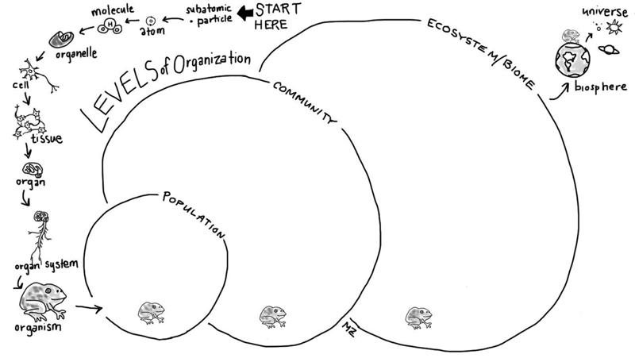
Now, use your frog to create each level. Fill out the circles with pictures of other frogs that will join your frog in its population, include the frog and other animals/plants/fungi/protists/bacteria in the community, and then all of the living & non-living things in the ecosystem.
© Getting Nerdy, LLC

Slide 16
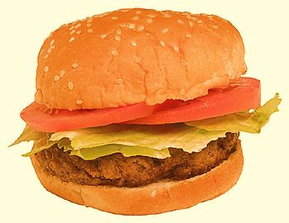
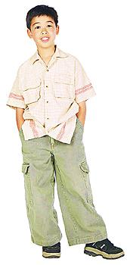
You are What You Eat!
Objective: To learn the various types of organisms within an ecosystem
Bell work:
1. DEFINE and give an EXAMPLE for:
a. Herbivore
b. Carnivore
c. Omnivore
d. Decomposer
2. Compare an autotroph with a heterotroph.
- Autotrophs (producers) make their own food
- Heterotrophs (consumers) can’t make their own food so they must eat it
plant eater (Ex: Deer)
meat eater (Ex: Wolf)
eats both plants and animals (Ex. Bear)
© Getting Nerdy, LLC

Slide 17

There are two types of organisms – those that can make their own food, and those that get their food from other sources.
1. Producers/Autotrophs: get their energy from the SUN through the process of photosynthesis.
Sunlight
Carbon Dioxide
Enters Stomata (tiny holes) in leaves
Oxygen
Exits Stomata
Glucose Sugar
Stored
Water
Enters through Roots
© Getting Nerdy, LLC

Slide 18

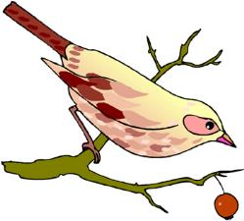
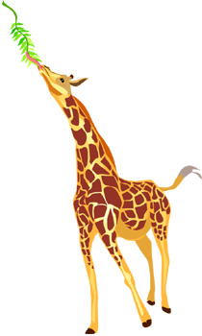
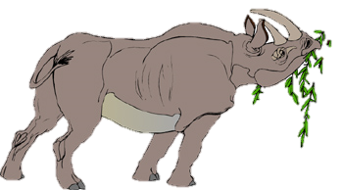
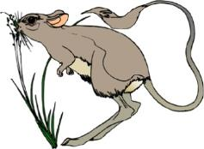
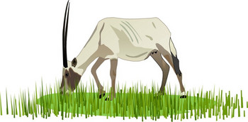
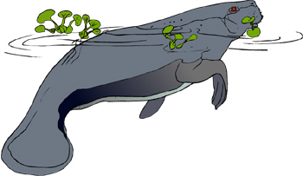
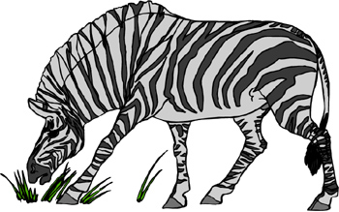
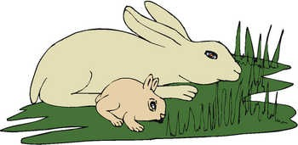
Consumers/Heterotrophs: get their food from other sources. There are 3 types:
  Herbivores: eat only plants
© Getting Nerdy, LLC

Slide 19
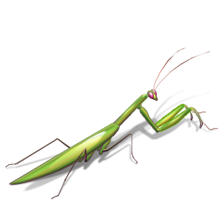
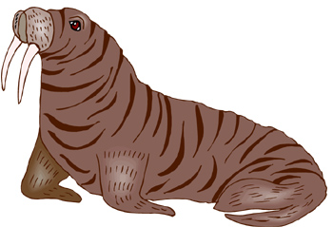

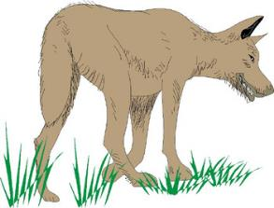
  Carnivores: eat only animals
© Getting Nerdy, LLC

Slide 20
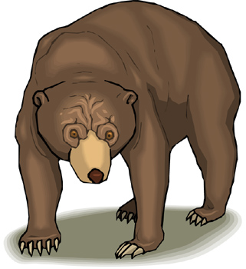
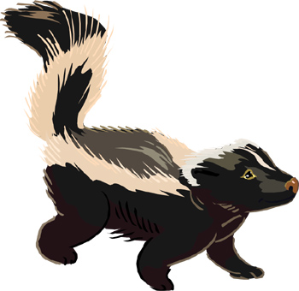
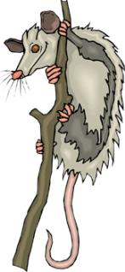
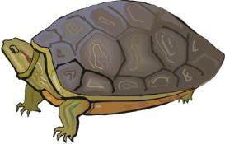


  Omnivores: eats BOTH plants & animals
© Getting Nerdy, LLC

Slide 21


  Scavenger: eats the leftovers
© Getting Nerdy, LLC

Slide 22

  Decomposer: breaks down decaying material
© Getting Nerdy, LLC

Slide 23



Do you know how these organisms get THEIR energy?
Carnivore, Herbivore or Omnivore??
Producer, Consumer or Decomposer??
© Getting Nerdy, LLC

Slide 24



You are what you eat!
Identify each organism in the diagram below and label each as a producer, decomposer, herbivore, carnivore or omnivore.
strawberry – producer; grasshopper – herbivore;
mouse – omnivore; snake – carnivore; hawk – carnivore;
mushrooms - decomposer
What do you think the direction of the arrow between each organism means?
energy moves in the direction of the arrow – from the organism being eaten, to the one that is eating it
nutrients
© Getting Nerdy, LLC

Slide 25
Food Chain: series of events in which one organism eats another and obtains energy. Each level is a “trophic” level.
Begins with light energy from the SUN.
© Getting Nerdy, LLC

Slide 26
Producers: make food (glucose) using the sun’s energy through photosynthesis:
6CO₂ + 6H₂O + sunlight & chlorophyll →C₆H₁₂O₆ + 6O₂
Sunlight
Carbon Dioxide
Enters Stomata (tiny holes) in leaves
Oxygen
Exits Stomata
Glucose Sugar
Stored
Water
Enters through Roots
© Getting Nerdy, LLC

Slide 27


Primary (1st) Consumer: eats producers/plants and can be an
Herbivore OR Omnivore
© Getting Nerdy, LLC

Slide 28
Secondary (2nd) Consumer: a carnivore or omnivore eats the primary consumer
OR
© Getting Nerdy, LLC

Slide 29

Tertiary (3rd) Consumer: eats primary or secondary consumers.
Called the “top of the food chain”
OR
© Getting Nerdy, LLC

Slide 30



Who feeds on EVERYTHING?
Scavenger: Carnivore that feeds on dead organisms.
Decomposers: break down decaying material and release nutrients into soil
Can you tell the difference between herbivores, carnivores, producers, decomposers, and scavengers within Africa?
nutrients
© Getting Nerdy, LLC

Slide 31


Food Chain!
nutrients
Organisms use the energy released in the food chain to power all of their daily activities through the process of cellular respiration
6O₂ + C₆H₁₂O₆ --> 6H₂O + 6CO₂ + energy
© Getting Nerdy, LLC

Slide 32



More Food Chains!
© Getting Nerdy, LLC

Slide 33

Food Web: many overlapping food chains in an ecosystem. Shows how ALL organisms interact within the ecosystem
Food Chain
Food Web
© Getting Nerdy, LLC

Slide 34

Food Chain & Web Games!
Simple starter food chain
Food Chain by I Know that!
Build a food chain
Ecosystem food chains
Woodland Food Web
Fun with Food Webs
HA! HA!
© Getting Nerdy, LLC

Slide 35

A Pyramid of Energy!
Objective: to determine how much energy is transferred or lost in an ecosystem.
Bell work:
What is the source of all energy?
The Sun
Why are decomposers considered nature’s recyclers?
They break down organic materials and return them to the Earth
© Getting Nerdy, LLC

Slide 36


Energy Pyramid
The sun is the ultimate source of energy for all living organisms
The sun provides energy directly to producers and indirectly to herbivores, omnivores and carnivores.
As you go up the food chain/energy pyramid, the amount of available energy decreases because you are getting further away from the original source of energy, the sun.
It takes a large number of producers to provide enough energy to a small number of primary consumers
It takes a large number of primary consumers to provide enough energy to a small number of secondary consumers
It takes a large number of secondary consumers to provide enough energy to a small number of tertiary consumers
© Getting Nerdy, LLC

Slide 37
Time for some Energy Transfer!
…We are going to calculate the amount of energy is transferred from the ULTIMATE source of all energy to the 3rd consumer…
We will start with…
© Getting Nerdy, LLC

Slide 38

THE SUN
Provides the energy for producers to conduct photosynthesis and make food.
ENERGY IN: 1000 units
© Getting Nerdy, LLC

Slide 39

1000
Fill in your chart with your calculations as we move along! Draw pictures neatly and color each one!
© Getting Nerdy, LLC

Slide 40

PRODUCER
A tomato plant gets the 1000 units IN. It uses 900 of those 1000 units to power its daily activities. Much of that energy is lost to the activities & surroundings. How much of the original energy is STORED?
© Getting Nerdy, LLC

Slide 41

900
1000
A. Tomato Plant
1000
900
100
Fill in your chart with your calculations as you see here! Draw your picture neatly and color it!
© Getting Nerdy, LLC

Slide 42

PRIMARY (1st) CONSUMER
The tomato hornworm loves tomatoes. When it eats the tomato, it only receives the energy stored – 100 UNITS. Of the 100 units of ENERGY IN, 90 units are used to power the worm’s daily activities and much of that energy is lost to the activities & surroundings. How much of the original energy is STORED?
© Getting Nerdy, LLC

Slide 43

900
1000
A. Tomato Plant
90
B. Hornworm
1000
100
900
90
100
10
Fill in your chart with your calculations as you see here! Draw your picture neatly and color it!
© Getting Nerdy, LLC

Slide 44

SECONDARY (2nd) CONSUMER
A Carolina Wren is flying up above and makes a tasty meal out of the hornworm, getting the 10 units of stored energy. Of the 10 units of ENERGY IN, 9 units are used to power the wren’s daily activities and much of that energy is lost to the activities & surroundings. How much of the original energy is STORED?
© Getting Nerdy, LLC

Slide 45

900
1000
A. Tomato Plant
90
B. Hornworm
9
1000
100
C. Wren
900
90
10
100
10
9
1
Fill in your chart with your calculations as you see here! Draw your picture neatly and color it!
© Getting Nerdy, LLC

Slide 46

TERTIARY (3rd) CONSUMER
A Red-tail Hawk is circling the field and sees the wren flying below. It swoops down to catch his meal, getting the 1 unit of stored energy as he eats it.
© Getting Nerdy, LLC

Slide 47

900
1000
A. Tomato Plant
90
B. Hornworm
9
1000
100
C. Wren
900
90
10
D. Red-tail Hawk
100
10
9
1
1
Your finished energy pyramid should look like this with pictures drawn and calculations complete!
© Getting Nerdy, LLC

Slide 48

Conclusion: As you move up the energy pyramid, only __% of the energy is transferred to the next level.
Organisms release waste and die. Decomposers take over and return nutrients to the earth.
THINK: If a tertiary consumer died, how much energy would be left for the decomposers?
0.1
10
© Getting Nerdy, LLC

Slide 49

A Pyramid of Energy -
Stacking It Up…
Objective: To demonstrate the transfer of energy through a food chain
Bell work:
Pick your favorite biome. As you picture it in your mind, imagine the types of organisms that inhabit that biome. Make a list of those organisms on your paper.
© Getting Nerdy, LLC

Slide 50
What You Do:
Choose a specific ecosystem from your notes that interested you the most. Then, think about the various types of organisms that inhabit that ecosystem. Of those organisms, choose a producer, primary consumer, secondary consumer and a tertiary consumer to create a food chain for that ecosystem.
Using the template on the next page, illustrate your food chain by drawing each organism in the circle. Pay close attention to the order in which you should create each level. Information is located at the edge of each template piece. Provide the name of the organism inside the bottom of each circle.
For each level, you should include information about the type of organism, whether is an herbivore, omnivore, carnivore or producer. Explain how each organism gets energy by describing what it eats or the process it uses to make energy. Calculate the energy transferred to each level of the pyramid in the appropriate place on your template
Once done, cut out each level of the template on the solid dark line. Create a ring by placing glue on the ends of each piece. Then stack each piece in the correct order, beginning with the sun as the base of your food chain. Use tape to secure the levels together to create your finished food chain.
© Getting Nerdy, LLC

Slide 51



Why Can’t We All Just Get Along?
Objective: To explain the types of relationships that exist between organisms
Bell work: Define the following terms in your own words:
Competition:
To fight for a resource
Predator:
The organism that hunts
Prey:
The organism that gets eaten
© Getting Nerdy, LLC

Slide 52





Predation: interaction where one organism (predator) kills another organism for food (prey)
© Getting Nerdy, LLC

Slide 53



Competition: struggle between organisms to survive as they attempt to use the same limited resource
© Getting Nerdy, LLC

Slide 54









Limiting Factors of Ecosystems
Limiting factor: an environmental condition or resource that limits the size of a population of organisms.
What are examples
of limiting factors?
-Food
-Water
-Weather
-Accidents
-Natural Catastrophe
-Disease
-Predators
-Space/Habitat
-Mate
-Competition
The largest population an area can support is its carrying capacity which is driven by limiting factors.
© Getting Nerdy, LLC

Slide 55



Interactions of Living Things
Symbiosis: close relationship created between two species due to coevolution (species evolve together in their environment).
The relationship must benefit at least one of the species.
=
?
OR
© Getting Nerdy, LLC

Slide 56




There are three types of symbiotic relationships:
Mutualism (+,+): relationship where both species benefit
Clownfish & Sea Anemone
Buffalo & Tickbird
© Getting Nerdy, LLC
Bumblebee & Flowers

Slide 57




Commensalism (+,0): relationship where one species benefits and the other species is neither helped nor harmed
Shark & Remora
Spanish Moss & Trees
Elephant & Egret
© Getting Nerdy, LLC

Slide 58



Parasitism (+,-): relationship where one species benefits (parasite) while the other is harmed (host)
Ticks & Mammals
Cuckoo Bird & Bird Nests
© Getting Nerdy, LLC
Mosquitoes & Mammals

Slide 59




Wanted: Symbiotic Relationship
Apply Within!
© Getting Nerdy, LLC

Slide 60
What You Do:
Create a classified advertisement/want ad for a job opening in which an organism in a symbiotic relationship is looking for the other organism. The ad should be based on a mutualistic, parasitic, or commensalistic relationship.
Headline describing job
Create a catchy headline to grab attention. Write a line describing the relationship you are seeking (mutualistic, parasitic, commensalistic), a line about who you are and the qualities you possess, a line about the type of organism you need for the job (Qualifications), a line about why you need this service, and a line describing what you will give the organism in return for his or her services.
Picture accompanying advertisement:
A picture showing you, the organism in search of the other organism. A picture showing the organism of which you are searching. A picture showing the two of you together in your symbiotic relationship - can be hand-drawn. Must be neat and colorful
Materials to use
To create this ad, use construction paper, copy paper, magazine/newspaper cutouts, clip art, computer graphics, photographs, hand drawn images, etc.
The ad can be done as a PowerPoint presentation, brochure, newspaper ad, magazine ad, poster, prezi presentation, glogster, etc.
© Getting Nerdy, LLC

Slide 61


WANTED: Lazy Pup with Short Nails
Desperately seeking a parasitic relationship. I am a flea with a thin body and springy legs who can jump 1,000 times my own body size! I am in search of a dog with long fur for me to cuddle up in, thin skin for me to bite, and short nails to keep from scratching me. I need your help because your blood is my nutrients and I need it to keep me alive. In return, I promise to give you the heebie jeebies and plenty of scabby bites to scratch and keep you busy!
ME YOU US TOGETHER
+
=
© Getting Nerdy, LLC

Slide 62
Listed below are several symbiotic relationships. Once you have been assigned your relationship, write the pair of organisms at the top of your paper. Research your relationship and follow all directions to complete your Want Ad.
Shark & Remora | Ants & Aphids
Mistletoe & Hardwood Tree | Pinworm & Humans
Bacteria & Termite Gut | Botflies & Deer
Ants & Acacia Tree | Oxpecker & Mammal
Honeyguide bird & badger | Sloth & Algae
Shrimp and Goby Fish | Botfly & Mammal
Tapeworm & Mammal | Fig Tree & Amazon Fruit Bat
Barnacles & Whales | Olive Baboon & African Elephant
Sea Anemone & Clownfish | Egrets & Cattle
Brownheaded cowbird & songbird | Wombat & Snails
Hermit Crab & Sea Anemone | Coyote & American Badger
Langur Monkey & Chital Deer | Egyptian Plover & Crocodile
Sea Slug & Algae | Human & Lice
Pygmy Seahorse & Seafan | Varroa destructor & Honeybee
Fig Wasp & Fig | Pompeii Worm & Thermophilic bacteria
Spanish Moss & Trees | Yucca Plant & Yucca Moth
Euprymna Bobtail Squid & Bioluminescent Bacteria | Leafhopper & Meat Ant
© Getting Nerdy, LLC

Slide 63
Analyzing Predator-Prey Relationships
Background:
The Midwest Grey Wolf has been taken off of the Endangered species list due to their numbers increasing. The resurgence began in northeast Minnesota and their populations have increased as the wolves move into territories that foster support for their steady growth. In Idaho, the wolf populations have had a great gain in population size due to an abundant food supply - Elk. The Fish and Game Department released the Lolo Elk counts for Wildlife Management Zones 10 and 12 and has detailed the data in the charts below.
Objective:
To analyze data demonstrating the effects of organism interactions on population size.
© Getting Nerdy, LLC

Slide 64
What You Do: Using the information provided in the charts below, analyze the data and answer the questions that follow.
The population change is the number of elk born minus the number of elk that died during that year. Fill out the last column for the year each year using the calculation below - Be sure to show if the change is positive or negative:
Elk calves – (Predation + Starvation) = Elk population change
For the year 2000: 800 – (400 + 100) = 300
An increase in elk population from the previous year.
Year | Wolf Population | Elk Population | Elk Calves | Predation | Starvation | Elk Population Change (-/+)
2000 | 10 | 2000 | 800 | 400 | 100 | +300
2001 | 12 | 2300 | 920 | 480 | 240
2002 | 16 | 2500 | 1000 | 640 | 650
2003 | 22 | 2210 | 944 | 880 | 389
2004 | 28 | 1885 | 996 | 1095 | 26
2005 | 25 | 1760 | 836 | 912 | 24
2006 | 21 | 1660 | 788 | 846 | 0
2007 | 18 | 1602 | 766 | 780 | 0
2008 | 19 | 1588 | 784 | 794 | 0
2009 | 19 | 1578 | 790 | 796 | 0
2010 | 19 | 1572 | 799 | 797 | 0
© Getting Nerdy, LLC

Slide 65
Check Your Answers!
Elk calves – (Predation + Starvation) = Elk population change
Be sure to show if the change is positive or negative
Year | Wolf Population | Elk Population | Elk Calves | Predation | Starvation | Elk Population Change (-/+)
2000 | 10 | 2000 | 800 | 400 | 100 | +300
2001 | 12 | 2300 | 920 | 480 | 240 | +200
2002 | 16 | 2500 | 1000 | 640 | 650 | -290
2003 | 22 | 2210 | 944 | 880 | 389 | -325
2004 | 28 | 1885 | 996 | 1095 | 26 | -125
2005 | 25 | 1760 | 836 | 912 | 24 | -100
2006 | 21 | 1660 | 788 | 846 | 0 | -58
2007 | 18 | 1602 | 766 | 780 | 0 | -14
2008 | 19 | 1588 | 784 | 794 | 0 | -10
2009 | 19 | 1578 | 790 | 796 | 0 | -6
2010 | 19 | 1572 | 799 | 797 | 0 | 2
© Getting Nerdy, LLC

Slide 66
Analyzing Predator-Prey Relationships
The Results – What Happened?
Graph your data by creating a DOUBLE LINE graph of the data from the chart on the previous page. Analyze the results and answer the questions that follow.
© Getting Nerdy, LLC

Slide 67





Biomes of the World
© Getting Nerdy, LLC

Slide 68


So . . . Thirsty! Dry Biomes
Objective: To learn the characteristics of dry biomes
Bell work: What are some examples of the different biomes of the world?
Desert Tundra
Savannah Taiga
Prairie Ocean
Rainforest Coral Reef
© Getting Nerdy, LLC

Slide 69
Take notes using the following slides. Use the pictures to help you fill in your biomes on your sheet by drawing an example of at least 1 plant and 2 animals for each biome. Be sure to draw neatly and to color your work.
© Getting Nerdy, LLC

Slide 70
Desert:
Details/Climate: Dry with little rainfall. Can be cold or hot. Sandy soil. Found all over the world
Animals: Birds, rodents, and reptiles that can survive extreme temperatures. Most hunt at night and live underground
Plants: Shrubs, cacti and yucca plants
© Getting Nerdy, LLC

Slide 71












Desert
© Getting Nerdy, LLC

Slide 72
Savanna:
Details/Climate: Dry. Found in Africa, India and Australia
African Savannah
Animals: lions, elephants, zebras, antelopes, hyenas
Plants: open grasslands with very few trees like acacia
© Getting Nerdy, LLC
dirty gerdy smelly mellie gnllc

Slide 73










Savanna
© Getting Nerdy, LLC

Slide 74
Prairie/Temperate Grassland:
Details/Climate: Dry, cold climate savannas. Found in North America, Russia and South Africa
American Prairie
Animals: Bison, elk, hawks, coyotes, and prairie dogs
Plants: Open grasslands with very few trees; clover, grasses, sunflowers
© Getting Nerdy, LLC

Slide 75






Prairie/Temperate Grassland
© Getting Nerdy, LLC

Slide 76



Reflection: The Battle At Kruger
After watching, write 3-5 sentences reflecting on the different kinds of events you saw- predator/prey, competition, food web, food chain, etc.
Exit Ticket: What would happen to the lion population if the outcome from the “Battle at Kruger” continued for years to come?
© Getting Nerdy, LLC

Slide 77

Brrrr!!! Cold Biomes
Objective: To learn the characteristics of cold biomes
Bell work:
What are some abiotic and biotic features of cold biomes?
© Getting Nerdy, LLC

Slide 78
Take notes using the following slides. Use the pictures to help you fill in your biomes on your sheet by drawing an example of at least 1 plant and 2 animals for each biome. Be sure to draw neatly and to color your work.
© Getting Nerdy, LLC

Slide 79
Arctic Tundra
Details/Climate: Cold and desert-like with permanently-frozen subsoil known as permafrost. Arctic Tundra = North Pole. Antarctic Tundra = South Pole
Arctic Tundra
Animals: lemmings, caribou, arctic hares, squirrels, arctic foxes, wolves, polar bears, falcons, loons, ravens, gulls, mosquitoes, black flies, salmon, & trout
Plants: low shrubs, grasses, lichen & mosses
© Getting Nerdy, LLC

Slide 80











Arctic Tundra
© Getting Nerdy, LLC

Slide 81
Alpine Tundra
Details/Climate: Mountains with cold, treeless, frozen landscapes.
Rocky Mountains
Animals: mountain goats, big horn sheep, ptarmigan, marmot, & bobcat.
Plants: Short shrubs, dwarf trees, and grasses
© Getting Nerdy, LLC

Slide 82










Alpine Tundra
© Getting Nerdy, LLC

Slide 83
Taiga/Coniferous Forest
Details/Climate: Most abundant biome. Cold with snowfall. Alaska, Canada, Scandinavia, and Russia
Animals: Beavers, lynx, wolves, moose, grizzly bears, and wolverines
Plants: forests of cold tolerant, dense evergreen trees covered in needles: pine, fir, spruce
© Getting Nerdy, LLC

Slide 84










Taiga/Coniferous Forest
© Getting Nerdy, LLC

Slide 85

Reflection: Polar Bear Habitat Loss
Watch this VIDEO about the state of polar bears. Write 5-7 sentences describing your understanding of ONE of the following topics:
how do the summer months affect the polar bear?
how does the health of polar bears indicate the health of the environment?
Exit Ticket:
Explain how the melting of the sea ice may affect people living on the coast of Florida.
© Getting Nerdy, LLC

Slide 86

Splish Splash . . . Wet Biomes
Objective: To learn the characteristics of wet biomes
Bell work:
List the biome that receives the most rainfall.
Tropical Rainforest
© Getting Nerdy, LLC

Slide 87
Take notes using the following slides. Use the pictures to help you fill in your biomes on your sheet by drawing an example of at least 1 plant and 2 animals for each biome. Be sure to draw neatly and to color your work.
© Getting Nerdy, LLC

Slide 88
Tropical Rainforest
Details/Climate: Warm, humid, rainy, near Equator. Most diverse biome with respect to animals and plants
Animals: Need trees for shelter/food. Monkeys, bats, frogs, jaguars, parrots and other colorful birds & insects
Plants: Dense, tall, evergreen trees. The tree “canopy” allows for little sunlight to reach ground, so very few low growing plants live here. Orchids, vines, ferns, mosses, and palms adapted for growth on trees
© Getting Nerdy, LLC

Slide 89









Tropical Rainforest
© Getting Nerdy, LLC

Slide 90
Temperate Deciduous Forest
Details/Climate: Moderate rainfall and humidity; less than a rainforest. North America, Asia, and Europe
Animals: Coyotes, birds, deer, squirrels, turkey, raccoons, opossum, and foxes
Plants: Trees, flowers, and shrubs grow in spring and summer, then lose their leaves and become dormant in winter (deciduous): maple, oak, willow
© Getting Nerdy, LLC

Slide 91










Temperate Deciduous Forest
© Getting Nerdy, LLC

Slide 92


Reflection: Gombe Forest
Watch this VIDEO about deforestation and an endangered group of chimpanzees.
Write 5-7 sentences about:
Why you think the forests of the Gombe are worth preserving? What are they currently doing to preserve the forests? Why is their program working? How have surrounding communities responded to the preservation?
Exit Ticket: Create a food chain using these organisms: Spider Monkey, Sun, Fig Tree, Jaguar, Slime Mold.
Save the trees!
© Getting Nerdy, LLC

Slide 93

Refreshing! Freshwater Biomes
Objective: To learn the characteristics of freshwater biomes
Bell work:
1. What are the abiotic and biotic factors of freshwater biomes?
© Getting Nerdy, LLC

Slide 94



Freshwater is defined as having a low salt concentration — usually less than 1% salt in the water. Organisms that live in freshwater regions cannot survive in high salt concentration.
River
(Fresh Water)
Estuary
(Brackish Water)
Ocean
Low salt concentration
High salt concentration
© Getting Nerdy, LLC

Slide 95
Take notes using the following slides. Use the pictures to help you fill in your biomes on your sheet by drawing an example of at least 1 plant and 2 animals for each biome. Be sure to draw neatly and to color your work.
© Getting Nerdy, LLC

Slide 96
Rivers and Streams
Details/Climate: Water that continuously moves in a single direction. Because of this, the communities are constantly changing to match the changing pace of the river. Found throughout the world
Animals: Trout, otters, wading birds, salmon, snails, and other fish, as well as animals from the surrounding habitat that use rivers for food and water
Plants: Algae - usually attached to rocks, liverworts, mosses, willows, river birch
© Getting Nerdy, LLC

Slide 97








Rivers and Streams
© Getting Nerdy, LLC

Slide 98
Lakes and Ponds
Details/Climate: A standing body of water that is created as streams and rivers empty into it
Animals: Phytoplankton, small fish, dragonflies, ducks, turtles, snakes, crustaceans, alligators, clams, and snails
Plants: Rooted (ex. elodea) and floating plants (ex. water lilies & water hyacinth)
© Getting Nerdy, LLC

Slide 99











Lakes and Ponds
© Getting Nerdy, LLC

Slide 100
Wetlands: Marshes, Swamps & Bogs
Details/Climate: Areas where the land is saturated with standing water. Wetlands have the highest species diversity of all ecosystems
Louisiana Wetland
Animals: Amphibians, reptiles, ducks, alligators, egret, nutria, and raccoons
Plants: Pond lilies, cattails, sedges, cypress trees, and black spruce
© Getting Nerdy, LLC

Slide 101








Wetlands: Marshes, Swamps & Bogs
© Getting Nerdy, LLC

Slide 102

Reflection: San Pedro River
Watch this VIDEO about the San Pedro river ecosystem.
Now answer the following:
1. Why do you think it is important to preserve the San Pedro river ecosystem?
2. What is threatening the San Pedro river and the organisms that live there?
3. Do you think the government’s decision to exempt the city from the endangered species act is right/wrong? Why?
© Getting Nerdy, LLC

Slide 103
Exit Ticket:
Which biomes are described below?
I am continuously moving and my communities change often. Many organisms visit me for food and water - what biome am I?
I am standing water on land, my soil is nutrient rich, and I am the most diverse biome - what am I?
© Getting Nerdy, LLC

Slide 104


Salty Stuff . . . Marine Biomes
Objective: To learn the characteristics of marine biomes
Bell work:
1. What are the abiotic and biotic features of marine or ocean biomes?
© Getting Nerdy, LLC

Slide 105



Marine (saltwater) regions cover about 3/4 of the Earth. Marine algae supply 90% of the world's oxygen and take in just as much carbon dioxide. Evaporation of seawater provides rainwater for the land.
Precipitation
Condensation
Surface Runoff
Evaporation
Accumulation
© Getting Nerdy, LLC

Slide 106
Take notes using the following slides. Use the pictures to help you fill in your biomes on your sheet by drawing an example of at least 1 plant and 2 animals for each biome. Be sure to draw neatly and to color your work.
© Getting Nerdy, LLC

Slide 107
Estuary
Details/Climate: Where freshwater streams & rivers meet the ocean. Freshwater brings nutrients from the inland which helps to increase diversity and productivity of the estuary
Animals: Oysters, clams, manatee, crabs, beluga whale, harbor seal, turtles, salmon, trout, and shorebirds
Plants: Algae, grasses, sea oats, tickseed flowers
© Getting Nerdy, LLC

Slide 108










Estuary
© Getting Nerdy, LLC

Slide 109
Beach (Intertidal Zone)
Detail/Climate: Where ocean meets land, and as waves and tides come in and out, the beach can be submerged or exposed. Because of this, the communities of plants and animals are constantly changing
Animals: Worms, clams, crabs, sea stars, snails, arthropods, crawfish, sea fleas and shorebirds
Plants: Mud and sand are constantly moving, so very few algae and plants can establish
© Getting Nerdy, LLC

Slide 110











Beach/Intertidal Zone
© Getting Nerdy, LLC

Slide 111
Coral Reef
Details/Climate: Includes warm shallow waters that receive lots of sunlight - usually near the intertidal zone. Also includes barriers around the edges of continents (Ex: the Great Barrier Reef off Australia)
Animals: Corals, zooplankton, clams/oysters, colorful fishes, sea urchins, eels, rays, sharks, octopus, sea anemones and sea stars
Plants: Algae, phytoplankton and seaweed
© Getting Nerdy, LLC

Slide 112








Coral Reef
© Getting Nerdy, LLC

Slide 113
Open/Deep Ocean & Benthic Zone (Ocean Floor)
Details/Climate: Includes cold waters far from the land = open ocean or deep ocean. The benthic zone or sea floor consists of sand & dead organisms. As you go deeper, the temperature decreases. Sunlight cannot penetrate through deeper water
Animals: Open ocean animals include whales, dolphins, deep sea fish, and plankton. On the sea floor are sponges, sea anemones, tubeworms, sea stars. Crabs, creepy deep sea fish live in deep ocean along with archaebacteria that live near thermal vents
Plants: Open ocean has surface seaweed. There are no plants in the deep areas (no sunlight)
© Getting Nerdy, LLC

Slide 114





Open/Deep Ocean & Benthic Zone (Ocean Floor)
© Getting Nerdy, LLC

Slide 115

Reflection: Lion Fish
Watch this VIDEO about the Lion Fish.
Write 3-5 sentences explaining:
What are some other ways we can prevent the problems with the Lionfish?
Exit Ticket: Why is it important that we not release aquarium pets into marine or freshwater biomes?
© Getting Nerdy, LLC

Slide 116





Just Keep Swimming!
Objective: To review marine biomes as we watch Finding Nemo
Bell work:
Create a food chain using the following: Sea turtle, fish, phytoplankton, sun, shark
What kind of SYMBIOTIC relationship does Nemo have with the Sea Anemone?
Mutualism
© Getting Nerdy, LLC

Slide 117
Finding Nemo… A Journey through the Ocean
Before You Watch:
What is a producer?
An organism that can make its own food through the process of photosynthesis
What is a consumer?
An organism that must obtain its food from another source (i.e. eating, absorbing)
What are the three types of consumers and what do they eat?
Carnivore – animals; herbivore – plants; omnivore – animals and plants
What is a primary consumer?
An herbivore or omnivore that eats the producer
What is a secondary consumer?
An omnivore or carnivore that eats the primary consumer
What is symbiosis?
A close relationship created between two species due to coevolution – the relationship must benefit at least one of the species

Slide 118
Finding Nemo… A Journey through the Ocean
Watch the movie and answer the questions that go along with it!

Slide 119

Biome Diorama = BIORAMA!
Objective: To create a 3-d model/diorama of a biome
Bell Work: Choose your TOP FIVE biomes from the list below:
Savanna: African or Australian
Desert
Prairie/Grassland
Alpine Tundra
Taiga/Coniferous Forest
Arctic Tundra
Tropical Rainforest
Temperate Forest
Wetlands: Swamps/Marshes
Lakes & Ponds
Rivers & Streams
Estuary
Intertidal Zone/Beaches
Coral Reef
Deep Ocean/Open Ocean
© Getting Nerdy, LLC

Slide 120

What is a Diorama anyway?!
A diorama is a model that recreates a natural setting showing a specific moment in time.
© Getting Nerdy, LLC

Slide 121
What You Need for this Project:
A Shoebox
Tissue paper
Glue/Glue gun
Crafty Materials
Once you know your biome, you can begin collecting:
Toothpicks, cotton balls, pipe cleaners, felt and scrap cloth, yarn
Magazine pics, clip art, Cardboard. Construction paper
Modeling Clay, Plastic figurines, Legos?
Real stuff: rocks, sand, dirt, twigs, dry mosses
Paints, markers, colored pencils,
GO TO A HOBBY OR CRAFT STORE FOR COOL STUFF or RAID YOUR KITCHEN & JUNK DRAWERS!
NO FOOD or LIVE PLANTS or ANIMALS ALLOWED!!
© Getting Nerdy, LLC

Slide 122

Your Research: Biorama Rough/Final Draft Sheet
Geographic locations for biome: countries, continents, states
Abiotic Factors:
Average Temperature-
Humidity/Precipitation-
Soil Type-
Latitude/Longitude-
Elevation/Topography-
Extra Info-
A list of your producers, primary consumers, secondary consumers, and tertiary consumers (top predator). If you list it here, you must include it inside your biorama; if you include it in your biorama, you must list it here.
Food web showing all of your organisms and their interactions
© Getting Nerdy, LLC

Slide 123
On the Biorama:
On the OUTSIDE of your SHOEBOX LID, fill out an index card providing the following information: Your name
Class period
Biome name
The final draft of your table pasted to the INSIDE of your SHOEBOX LID
© Getting Nerdy, LLC

Slide 124
BIORAMA SETUP
OUTSIDE OF BOX LID INSIDE OF BOX LID
Top covered in tissue paper
Carved out hole for peering in
Biome Diorama Table
Geography:
Abiotic Factors:
Organisms:
Food Web:
Name Class
Biome
© Getting Nerdy, LLC

Slide 125
What Needs to be Included?
In the Biorama:
Biotic factors of your environment:
2 Producers
2 Primary consumers
2 Secondary consumer
1 Tertiary consumer/Top Predator
Abiotic factors of your environment:
4 features such as rocks, sun, clouds, soil, water, air, etc.
Use the cut out hole to peer in your box and arrange all of your organisms, plants, and abiotic factors so that the viewer sees as much as possible of your 3-d model.
© Getting Nerdy, LLC

Slide 126
Biorama Examples
Student designed and student made!
Creative!
Range from inexpensive (crafty handmade figures) to pricey (store bought figures and model kits).
All photos are taken from the carved out hole on the side of the box!
© Getting Nerdy, LLC

Slide 127

Arctic Tundra
© Getting Nerdy, LLC

Slide 128


Deserts
© Getting Nerdy, LLC

Slide 129



Wetlands: Marshes & Swamps
© Getting Nerdy, LLC

Slide 130


Taiga, Coniferous or Boreal Forest
© Getting Nerdy, LLC

Slide 131



Lakes, Ponds & Rivers
© Getting Nerdy, LLC

Slide 132


Oceans
Deep Ocean
Ocean Floor
© Getting Nerdy, LLC

Slide 133


Oceans
Coral Reef
Intertidal Zone (Beach)
© Getting Nerdy, LLC

Slide 134


Savanna
Grassland
© Getting Nerdy, LLC

Slide 135


Rainforest
© Getting Nerdy, LLC

Slide 136

Prairie/Grasslands
© Getting Nerdy, LLC

Slide 137

Last Stand of the Great Bear
Objective: To explain how living things interact with one another
Bell work: On your notes sheet, identify each of the following organisms by the type of food that they eat:
1
Herbivore
3
Omnivore
5
Decomposer
Carnivore
2
Scavenger
4
© Getting Nerdy, LLC

Slide 138

“The Last Stand of the Great Bear” is not about bears. In fact, it’s about a very special temperate rainforest in North America called the Great Bear. Here, many plants and animals interact with each other in unique ways. Complete the questions that go along with the movie as you watch.
© Getting Nerdy, LLC

Slide 139


Ecology Review: A Scavenger Hunt
Objective: to prepare for your ecology test
Bell work:
If the amount of energy from the sun into an ecosystem equals 1000, how much energy would be available for the 4th consumer/decomposer?
0.1 units to the 4th consumer
What if the amount of energy from the sun equaled 2000 units? What would be left over for the 2nd consumer?
20 units to the 2nd consumer
© Getting Nerdy, LLC

